Slide 1

A/B Testing and Experimentation
Batch 33| Bootcamp Data Science

Slide 2


LinkedIn
Arga Adyatama
Arga Adyatama
My writing
Github
Blog post
Mentor
Loyalty Data Analyst
Kawan Lama Group

Slide 3
Outline
A/B Testing Philosophy
Design A/B Test
Evaluate A/B Test
What is A/B testing?
Why we do A/B testing?
When we do A/B testing?
Develop hypothesis
Define success & guardrail metrics
Define control and variant groups
Type of test
Statistical test
Parametric
Non-parametric

Slide 4
Prepare Your Drive

Slide 5
Get the Materials
The whole materials can be found here
Prepare your own drive folder that at least contain the following items to get better learning experience:
Copy of hands_on_ab_testing_statistics.ipynb
Copy of news_ab_test.csv

Slide 6
Introduction

Slide 7
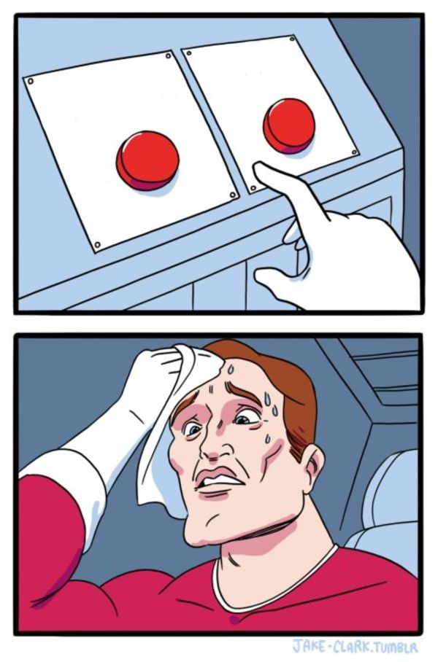
Option B
Option A
Have You Ever Need to Make A Big Decision?

Slide 8

How Companies Release New Medication?
Do they just develop a new drugs and quickly sell them to customers?

Slide 9


Risk Mitigation
Why does the guy not afraid to climb a vertical wall?
What does this 2 pictures have in common?

Slide 10
Mistakes happen,
learn from them,
iterate and improve

Slide 11

A/B Testing
Instead of directly launching the new change into all of user, try experimenting with smaller subset of user
A/B testing is a controlled experiment that measures the impact of a change on a subset of users
Apply change into all user
Experiment with smaller user
New Variant
New Variant
Other user – not part of experiment
Control

Slide 12

A/B Testing
User will be divided into 2 different groups
Control: user who doesn’t receive any change/new feature
Variant: user who receive change/new feature
Blue Water Bottle
Control
Rp 200.000
Rp 150.000
Blue Water Bottle
Variant
Rp 200.000
Rp 150.000

Slide 13



Why A/B Testing
Help us making informed decision based on data
Mitigate risk by doing trial on a smaller scale
Understanding what users want and need from the product. Capture customer’s feedback earlier.

Slide 14
Experiment Design

Slide 15
Step-by-step A/B Testing
The typical steps in building an A/B testing experiment
Identify a change to evaluate
Create a hypothesis
Define metrics
Success metrics
Guardrail metrics
Define sample
Select eligible users
Define the testing duration and number of samples
Randomly split them into control group & variant group
Evaluate the result

Slide 16
Identify Change and Hypothesis
Define what a change to evaluate or what kind of decision that needs to be evaluated. It can be a proposal or a mock up design. Show both the current condition and the proposed change/variant and highlight the difference.
Example
We want to change the color of the discounted price from black to bright red
Blue Water Bottle
Control
Rp 200.000
Rp 150.000
Blue Water Bottle
Variant
Rp 200.000
Rp 150.000

Slide 17
Create a Hypothesis
Your hypothesis statement communicates what you believe will happen by introducing a change to your users so it’s clear to anyone.
Use the following template on creating a hypothesis statement
We believe [the solution] will give/make [the success definition] because [rationale or evidence for the prediction]
Example
We believe [by changing the color of discounted price] will make [more people to purchase] because [the bright red color is more noticable and make the user more interested to the discount]

Slide 18
Define Metrics
Success Metrics
Guardrail Metrics
A success metric, also referred to as a primary metric, is the metric you measure to demonstrate that the A/B test had the predicted effect
Guardrail metrics, also called secondary metrics, are used to ensure that a change does not have an unintended effect, especially ones of the negative kind
Conversion rate (CVR)
% of user who make a purchase
If users are more interested to the discount, they will be more likely to purchase
Click-Through Rate (CTR)
% of user who click the product
If users are more interested to the discount, they will be more likely to click the product
Total Revenue
If the conversion increase but significantly lowers total revenue, it might not be a good trade-off. A change should lead to higher revenue.
Average Order Value (AOV)
Total revenue / total order
We are happy that more people make purchase, but we don’t want them shifting to buy cheaper product
Cart Abandonment rate
% of user who add to cart but doesn’t convert
We want people to make purchase, not just adding new items to cart
Example of e-commerce metrics

Slide 19
Define Metrics
Success Metrics
Guardrail Metrics
A success metric, also referred to as a primary metric, is the metric you measure to demonstrate that the A/B test had the predicted effect
Guardrail metrics, also called secondary metrics, are used to ensure that a change does not have an unintended effect, especially ones of the negative kind
Total Expend on Transport
Mengurangi pengeluaran untuk transportasi dengan pindah dari ojol ke transum
Trip Duration
Lama waktu perjalanan, gakpapa saya masih oke kalo waktunya tambah, tapi kalo sampai > 2 jam saya gak mau

Slide 20


Define Sample
Not all user may be eligible for being part of an A/B testing
Make sure the right type of users are selected as part of A/B testing experiment
Example
Testing text push notification for add to cart reminder
Eligible sample
People who has abandoned cart
Not Eligible
People who don’t have abandoned cart

Slide 21


Test Duration
Define the Minimum Detectable Effect (MDE): what is the percent of change you want to see in conversion (if your metric is conversion rate)
Run the test until we have enough/minimum sample to evaluate the test statistically or we can run the test based on available resource, e.g. promo budget
The A/B testing should run long enough to reduce the bias of seasonal effect, e.g. weekday vs weekend, payday vs non-payday
Sample size calculator

Slide 22

Randomization
Randomly split target user into control group & variant group
Randomization is done to make sure the results are statistically valid and are not biased toward certain group of user
Blue Water Bottle
50%
Rp 200.000
Rp 150.000
Blue Water Bottle
Users
50%
Rp 200.000
Rp 150.000

Slide 23
Type of Experiment
Superiority Testing
Non-Inferiority Testing
To demonstrate that the new version performs better than another version or is superior to the control.
Example
Make the purchase button bigger We want to determine if this change would lead to higher conversion rate
Changing voucher policy We want to see if reducing the minimum purchase for cashback voucher from 100K to 50K will result in higher user retention
To determine if the new change is not worse than the existing or control.
Example
Rising subscription fee We want to determine if rising the subscription fee wouldn’t hurt the subscription rate or user retention
Optimizing product recommendation system Changing from using 3 years of data to only 1 year of data to cut the cloud computing cost. We want to see if the new recommendation system wouldn’t perform worse than before.

Slide 24
Let’s Practice

Slide 25

Design A/B Testing for News App
NewestNews is an online news platform with a freemium where user can read 5 free articles every month or subscribe to get full access on all news
The product lead want to increase the subscription rate by introducing a new layout for their page from list to a grid, allowing user to see more content at once
Control
Variant
News A
Summary
News A
Summary
News B
Summary
News C
Summary
News B
Summary
News C
Summary
News D
Summary
News E
Summary
News F
Summary

Slide 26
Design A/B Testing for Promo
Write down your hypothesis
What is the success metrics?
What is the guardrail metrics?
What is the type of experiment? Superiority or Non-Inferiority test?
Find the right sample
Current subscription rate = 20%, we want to increase it by 5%, weekly traffic 100,000
Who are eligible for being part of the experiment?
When and how long should the experiment run?

Slide 27
Evaluate A/B Test

Slide 28

Statistical Test
Since we are collecting samples during AB test, evaluating the result should be done with statistical test
Statistical testing will help us determine if the change is significant and not just due to random variation

Slide 29
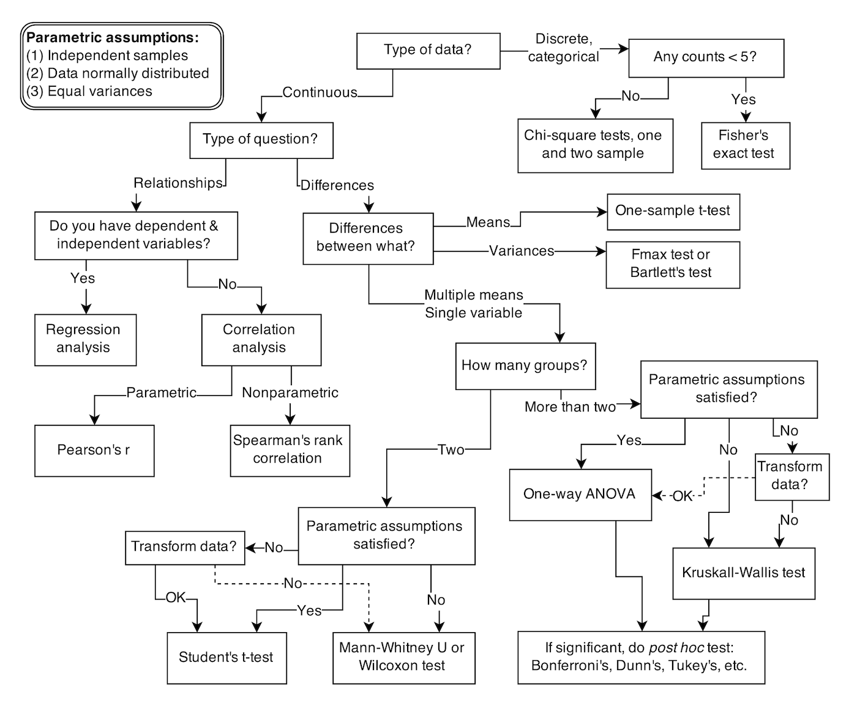
Statistical Test
So many tests for different scenarios
Statistical Rethinking, McElreath

Slide 30

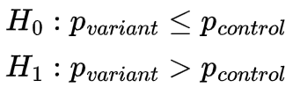
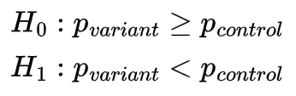
Proportion Z-test
For comparing proportion between 2 group of sample
Require the data to be a proportion and not a numeric value
Example of metrics
CVR/conversion rate
CTR/click-through rate
Retention rate
Bounce rate
Email open rate
Subscription rate
Superiority Test
Non Inferiority Test

Slide 31


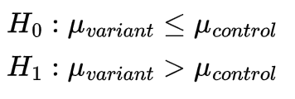
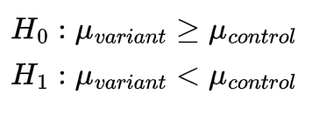
Difference in Numeric Value
For comparing the mean between 2 group of sample
Require the data to be numeric value
Typical test
Independent t-test
Mann-Whitney U test
Example of metrics
Total time spent on app
Total page views
AOV
RPV
Superiority Test
Non Inferiority Test

Slide 32
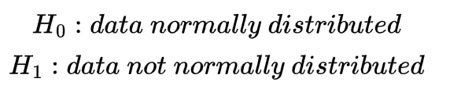
Difference in Means with t-test
t-test compare the mean value between 2 group of samples
t-test require both group of sample to be normally distributed
Normality can be checked using Anderson-Darling test
Superiority Test
Anderson-Darling Normality Test
Non Inferiority Test

Slide 33
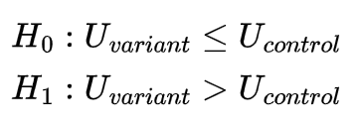
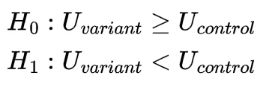
Mann-Whitney U test
Mann-Whitney doesn’t require both group of sample to be normally distributed
Mann-Whitney test is less powerful than t-test, so we should only use it when we can’t use the t-test
Superiority Test
Non Inferiority Test

Slide 34
Terima Kasih

Slide 35



